Slide 1


Development of Practice Education
An international and local project
Building Bridges (BUIBRI) between Europe and China to strengthen social work profession
University of Hertfordshire
Dr Echo Yuet Wah Yeung
楊月華 博士

Slide 2
Outline of the presentation
Background of the BUIBRI Project
How different research methods were used to inform and evaluate development of the project
Outcomes / findings of the evaluation: implications for practice education in international and local context

Slide 3
Background of the BUIBRI Project
November 2017 to Sep 2021
The project consortium includes three European Partners and three Chinese Partners:
University of Eastern Finland (Finland)
Gothenburg University (Sweden)
University of Hertfordshire (UK)
Fudan University in Shanghai
Sun Yat Sen University in Guangzhou
Nanjing Normal University in Nanjing
Notes:
A three year project, funded by Erasmus + grant

Slide 4
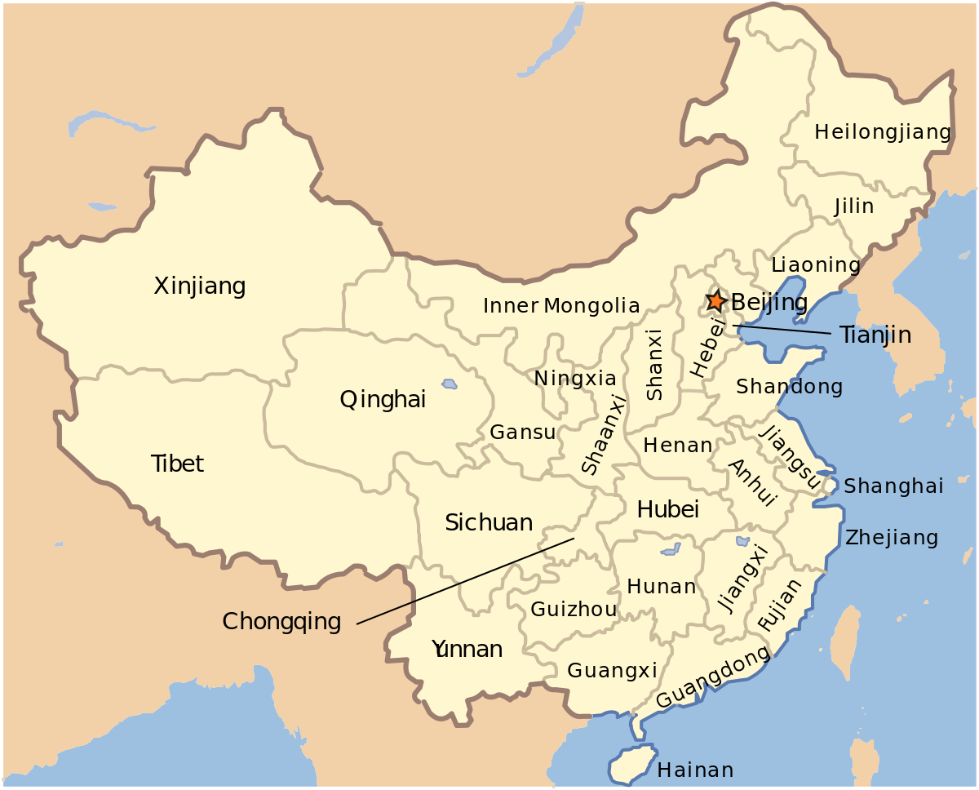
Nanjing
Shanghai
Guangzhou

Slide 5
Aims
to strengthen the Chinese Higher Education's capacity, to further develop and promote social work education in China
to address the core need to develop practice learning in social work education programs in China
to embed research in professional development and social work practice

Slide 6

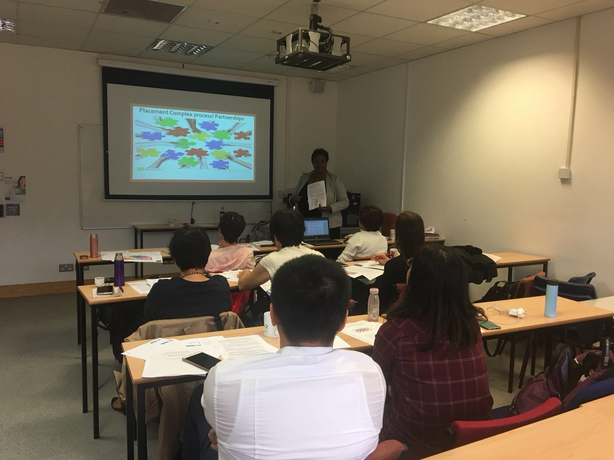
Preparation for training for trainers workshop
August 2018 in College Lane, Hatfield

Slide 7
Content of training sessions
Practice learning journey
What make a positive practice learning environment
Learning theories
Supervision model
Collegial supervision
Reflective practice
Assessment methods
Working with struggling students
Embed research in practice learning

Slide 8
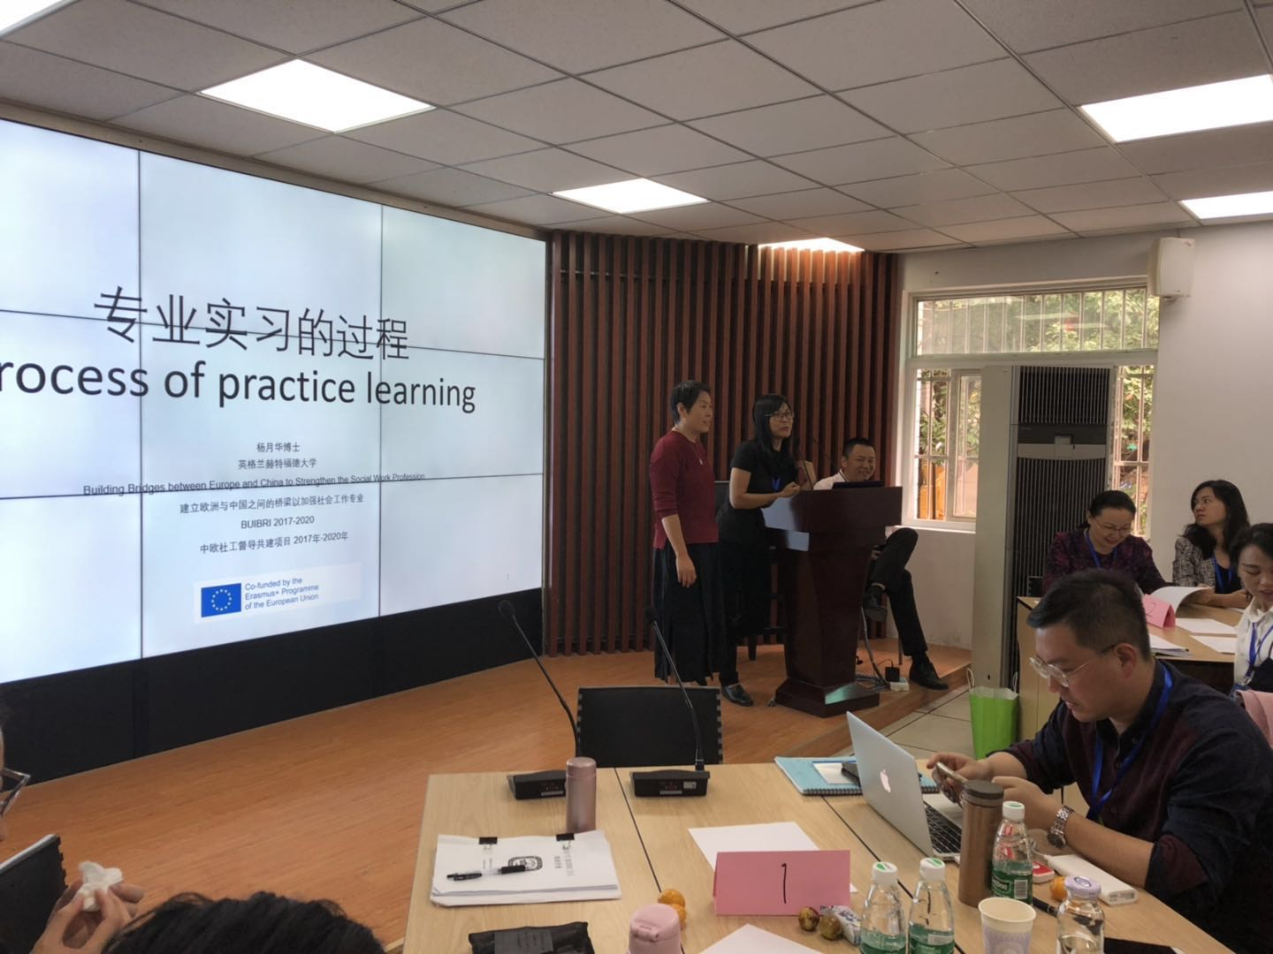
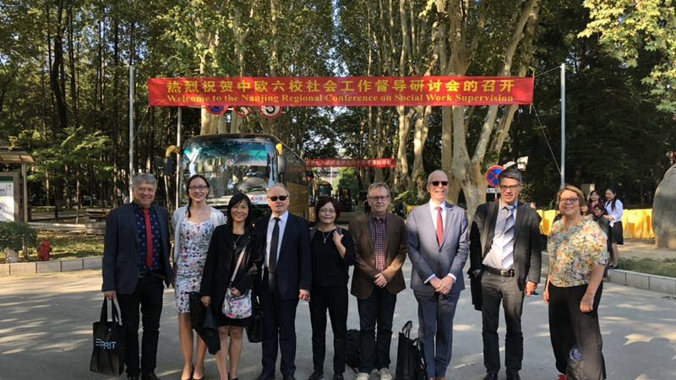
Training for trainers:
3-day training in October 2018 in Nanjing
The 30 trainers then delivered the training to 600 practice educators between April 2019 and April 2021

Slide 9
China: evaluation of training programme
Self-efficacy questionnaires (Holden et al., 2002) were used to ask practice educators to assess their perceived confidence in undertaking their role as practice educators
Self efficacy questionnaires, practice educators were to complete a questionnaire at three points: T1 (before the training), T2 (after the training) and T3 (upon completion of students’ placements) for 600 practice educators
Three focus groups with 18 practice educators
Three focus groups with 23 students
Notes:
concept of self-efficacy indicates a person’s perceived confidence in completing certain tasks by executing their skill sets.

Slide 10
Practice Educators’ perspective from focus groups:
Knowledge
Kadushin and Harkness’ (2014) supervision model (administrative, educational and supportive functions, structure of supervision)
Reflective model (Gibbs model, group supervision)
Values
Looking from students’ perspective and getting to know students as individuals
Important of communication with students亦师亦友 collaborative learning
Skills
Skills training to support students to develop professional identity

Slide 11
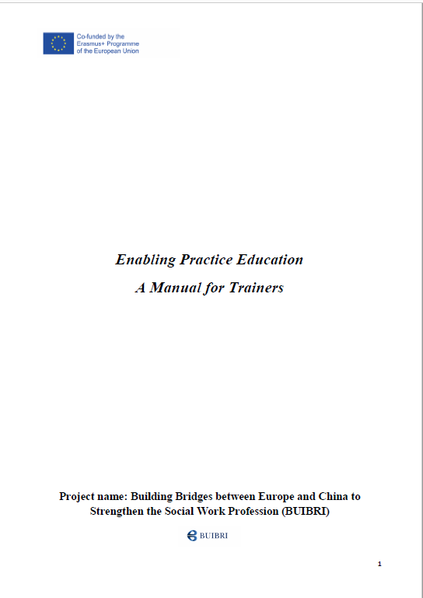
Outcomes:
Training for Practice Educator Handbook (Chinese version)

Slide 12
Students’ perspective
Want regular and structured supervision
A good range of learning opportunities
Timely, critical and constructive feedback
More guidance about professional development
Students wanted to be listened to and treated as an individual, their individual learning needs

Slide 13
Hertfordshire: Feb 2019 to Dec 2019 integrating theory and research in practice education
Workshops with students, practice educators and university tutors to seek their perspectives how to help students to integrate theory and research in their practice in placement
Workshop with practice educators, development of ‘applying research to practice’ module in July 2019
Pilot two sessions ‘undertaking the idea of research’ 13 practice educators and ‘applying research in practice setting: using case studies’ 40 trainee practice educators in Dec 2019

Slide 14
Outcome: Students’ Perspective
What helps to apply theories / research to practice?
Highly value practice wisdom from practice educators
Observation of experienced practitioners’ practice
Discussion in individual and group supervision
Reflective logs
Being proactive in learning
https://www.youtube.com/watch?v=DpqVIKAQx3Y&t=87s

Slide 15
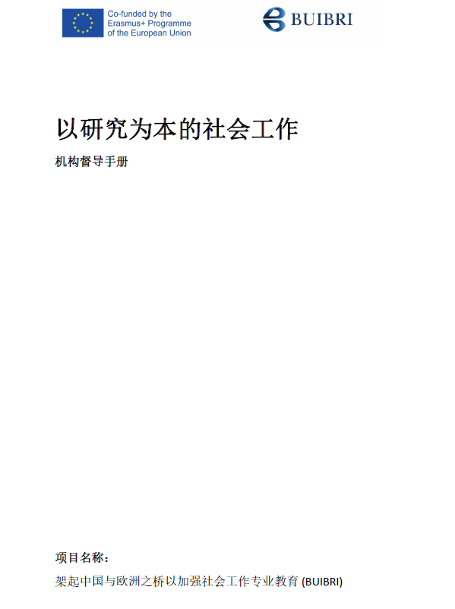
Outcomes:
Evidence-based social work: handbook for practice educator

Slide 16
Any Questions ?

